Slide 1
Comprehension
Lesson 4
Mrs.West

Slide 2
Review our Procedures
Give it your BEST try.
Use tools appropriately .
Be Respectful.
The mysterious world of Neurons

Slide 3
Notebook
Growth Mindset: How do your neurons connect by challengings yourself?
Q1:
Q2:
Q3:
What did you learn?

Slide 4
Agenda Today
Growth Mindset
Power of Neurons
Vocabulary
Author’s Purpose

Slide 5
Making Connections
Review! How can we do this and why do we do it?
Readers making connections about the text to themselves, the world around them, or other books they have read

Slide 6
Visualization
Readers use visualization to better understand a text. When
you use visualization, you use details to create pictures in
your mind. You imagine what is happening in the text.

Slide 7
5 Ws
Strong Readers ask questions when they read a text. Asking questions before, during, and after helps in understanding a text.

Slide 8

Author’s Purpose
PIE
The MAIN reason for the story
Persuade - the authors writes to get you to do something or believe what they say
Inform - the author writes to give you information about a topic
Entertain - the author writes to tell you a story that you will enjoy

Slide 9
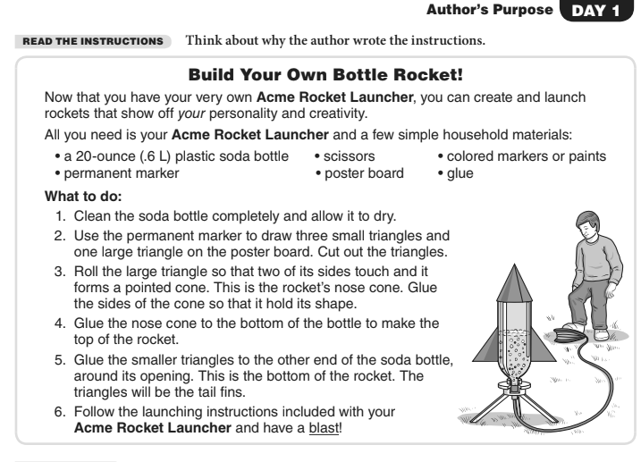

Slide 10
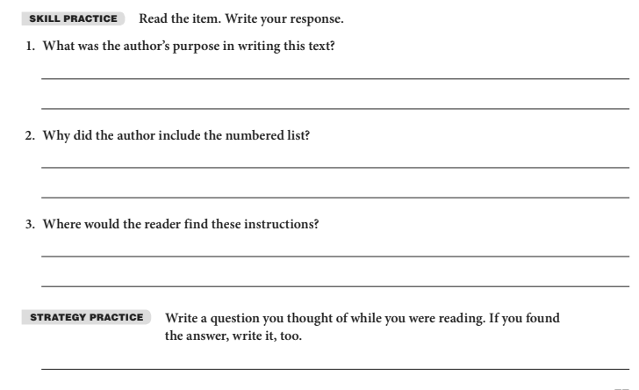

Slide 11
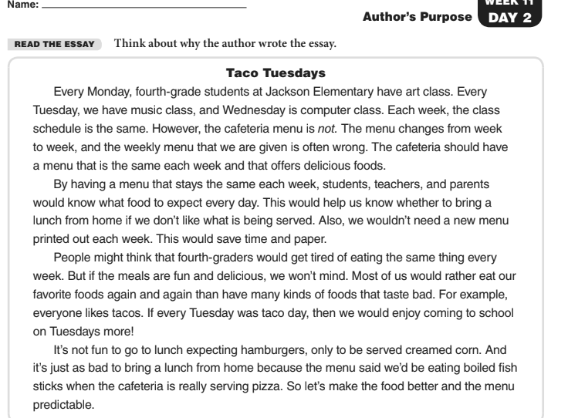

Slide 12
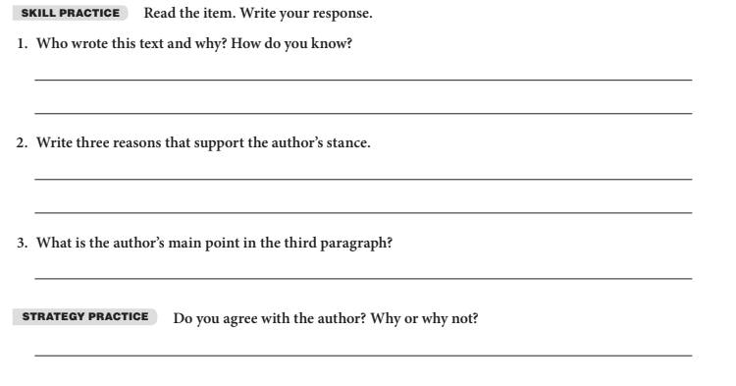
I think a 4th grader wrote the story. I know this because they used the word we when describing what they wanted.
The first reason is the school would save money. The second reason would be the students would be happier to come to school. The third reason is the would get to eat their favorite food at school.
The students would rather eat the same food every week because it would be their favorite food.

Slide 13
SBAC Testing
Go to website

Slide 14
Review what we learned
The Power of Yet
Vocabulary
Organization

Slide 15
Week 4 Goal
Practice Making Connections to the stories you are reading!
Practice Visualizing the story! Make a movie in your head.
Practice working on understanding the organization of the story.
Review the 5 W’s

Slide 16
Thanks!
Any questions?
You can always email me:
kelly.west@heartlandcharterschool.org

