Slide 1
Comprehension
Lesson 3
Mrs.West

Slide 2
Review our Procedures
Give it your BEST try.
Use tools appropriately .
Be Respectful.
The power of Yet

Slide 3
Notebook
Growth Mindset:
Q1:
Q2:
Q3:
What did you learn?

Slide 4
Agenda Today
Meet Dojo- The Power of Yet
What can Katie learn from Dojo?
Vocabulary
5 W’s

Slide 5
Making Connections
Review! How can we do this and why do we do it?
Readers making connections about the text to themselves, the world around them, or other books they have read

Slide 6
Visualization
Readers use visualization to better understand a text. When
you use visualization, you use details to create pictures in
your mind. You imagine what is happening in the text.

Slide 7
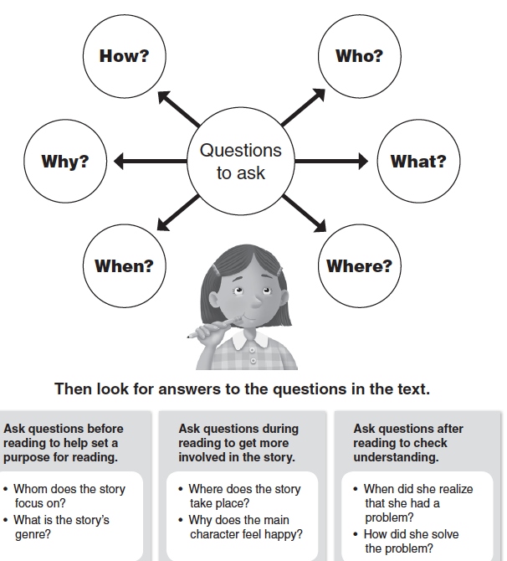
5 Ws
Strong Readers ask questions when they read a text. Asking questions before, during, and after helps in understanding a text.

Slide 8
Swimming with Dolphins
Type in 2 questions you already have about the story we will read

Slide 9
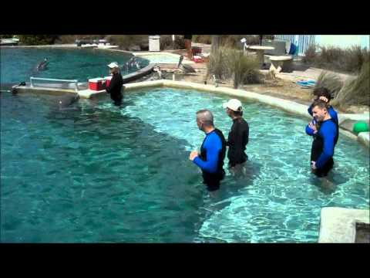
Vocabulary

Slide 10
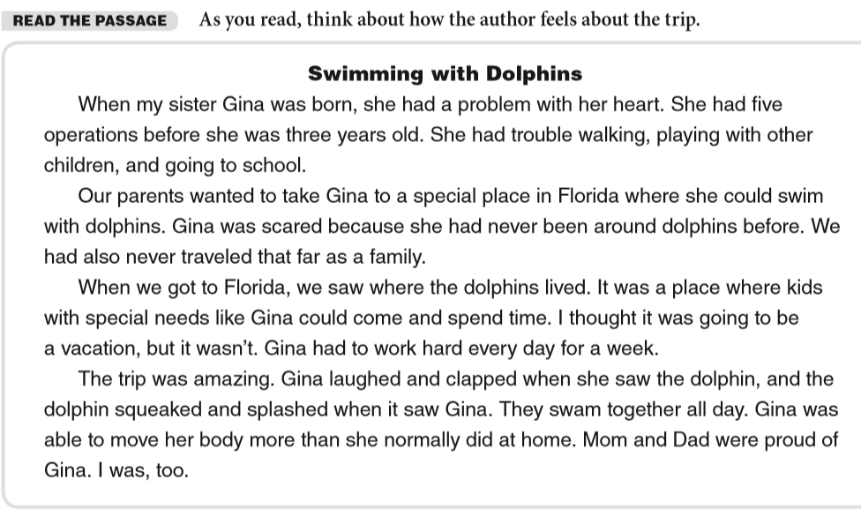

Slide 11
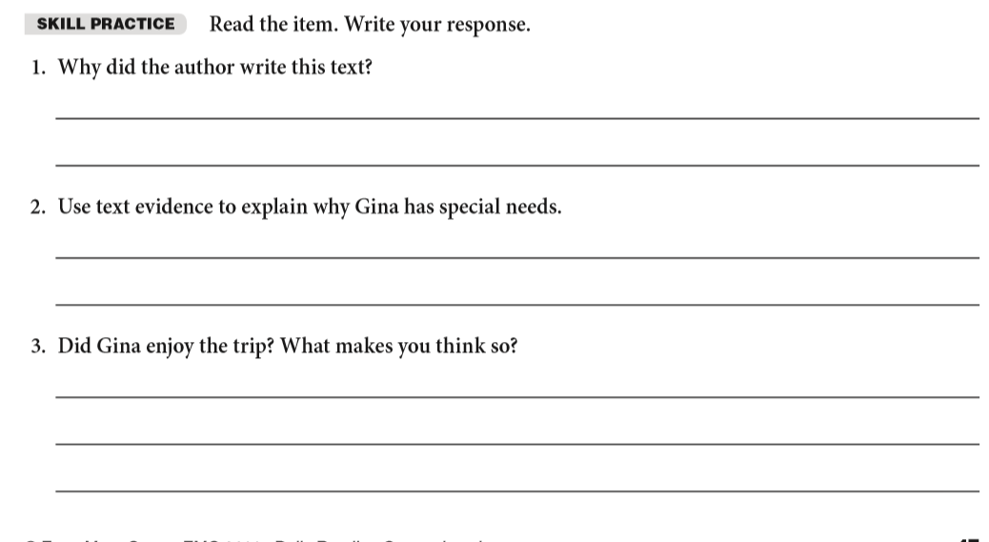
I think Gina has special needs because the story said, “ “.
I think Gina enjoyed the trip because _________ .

Slide 12
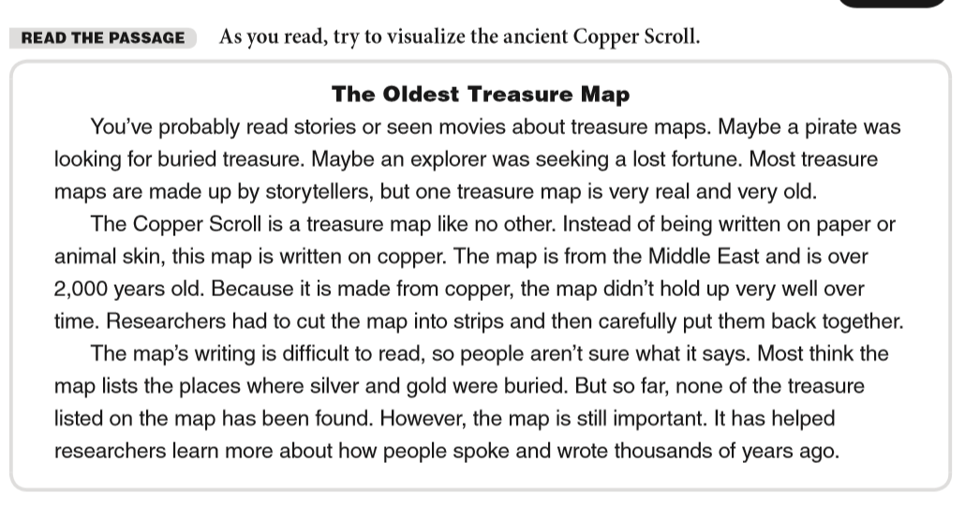

Slide 13
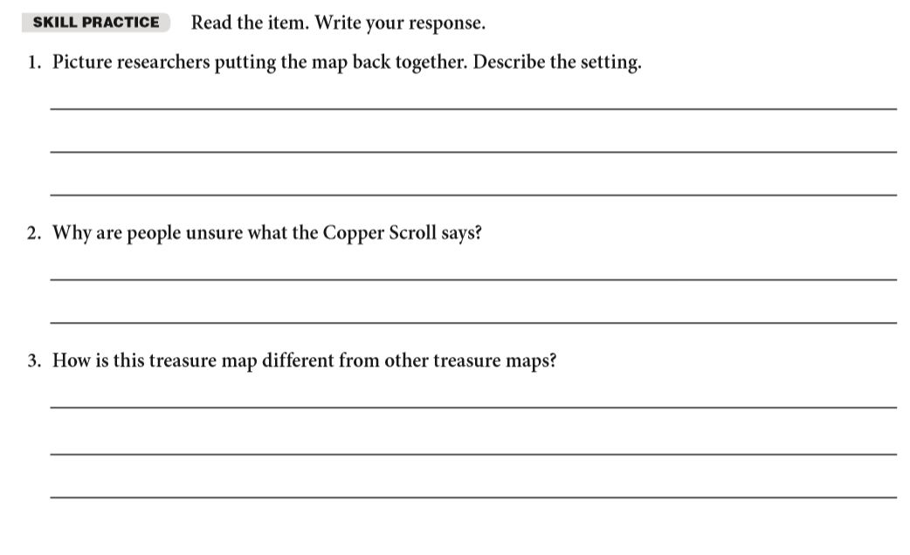

Slide 14
Review what we learned
The Power of Yet
5 Ws - How can this help you in understanding the story
Visualization

Slide 15
Week 3 Goal
Practice Making Connections to the stories you are reading!
Practice Visualizing the story! Make a movie in your head.
Now, work on understanding the 5W’s of the story.
Website

Slide 16
Thanks!
Any questions?
You can always email me:
kelly.west@inspireschools.org

