Slide 1
Comprehension
Lesson 2
Mrs. West

Slide 2
Review our Procedures
Give it your BEST try.
Use tools appropriately .
Be Respectful.

Slide 3
Notebook
Growth Mindset:
Q1:
Q2:
Q3:
What did you learn?

Slide 4
Agenda Today
Meet Dojo- The Magic of Mistakes
Vocabulary
Making Connections
The magic of Mistakes

Slide 5
I Can!
I can describe the characters in a story and explain how their actions add to the story’s events.
I can determine the meaning of words and phrases I do not know.

Slide 6
Visualization
Readers use visualization to better understand a text. When
you use visualization, you use details to create pictures in
your mind. You imagine what is happening in the text.

Slide 7
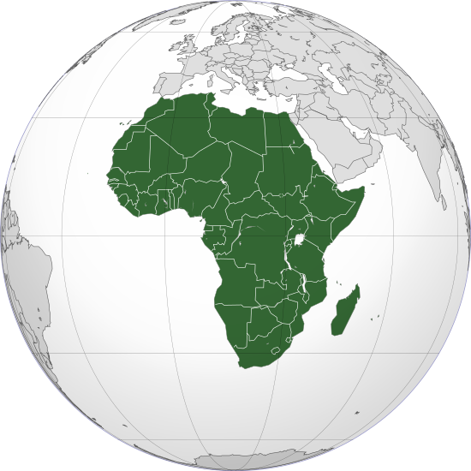
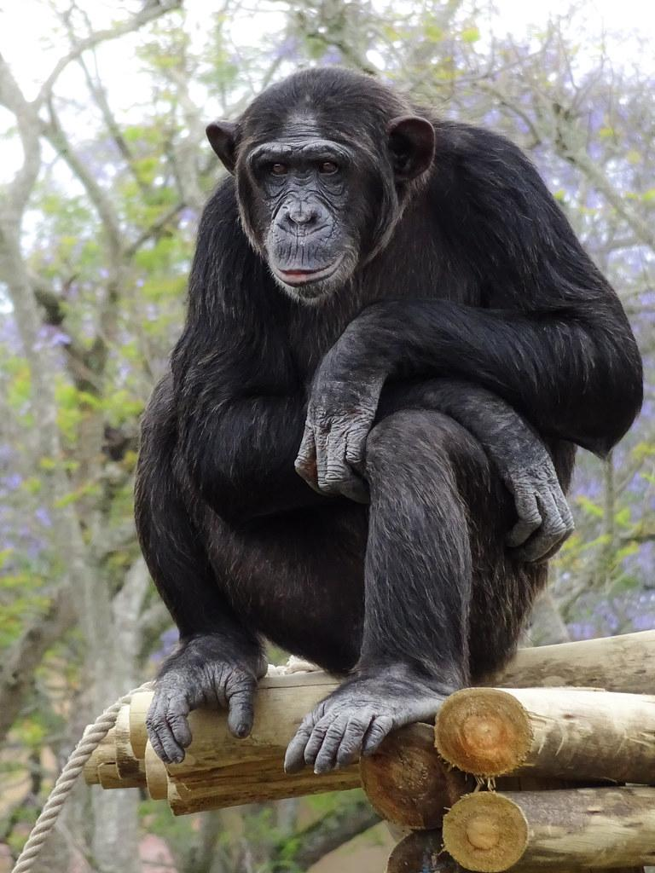
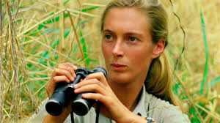
Vocabulary
Africa
Chimpanzee
Jane Goodall

Slide 8
Making Connections
Readers making connections about the text to themselves, the world around them, or other books they have read

Slide 9
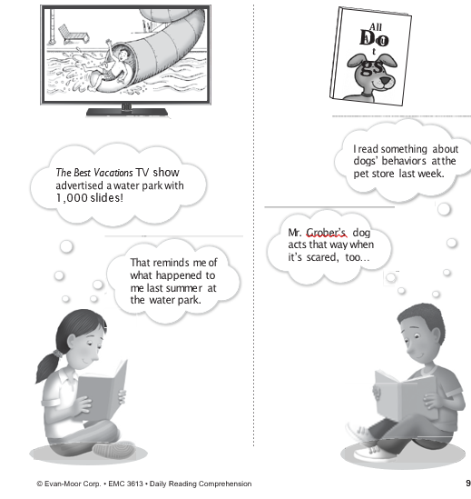

Slide 10
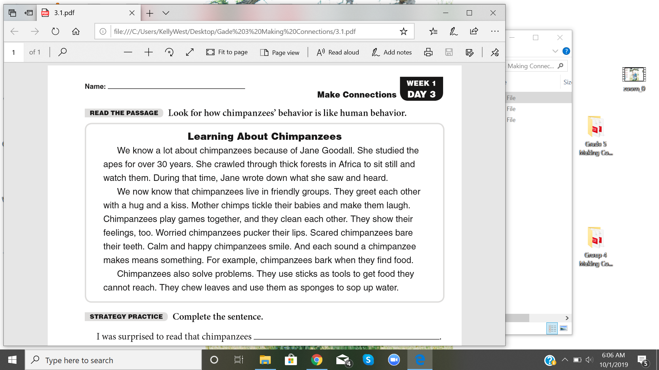

Slide 11
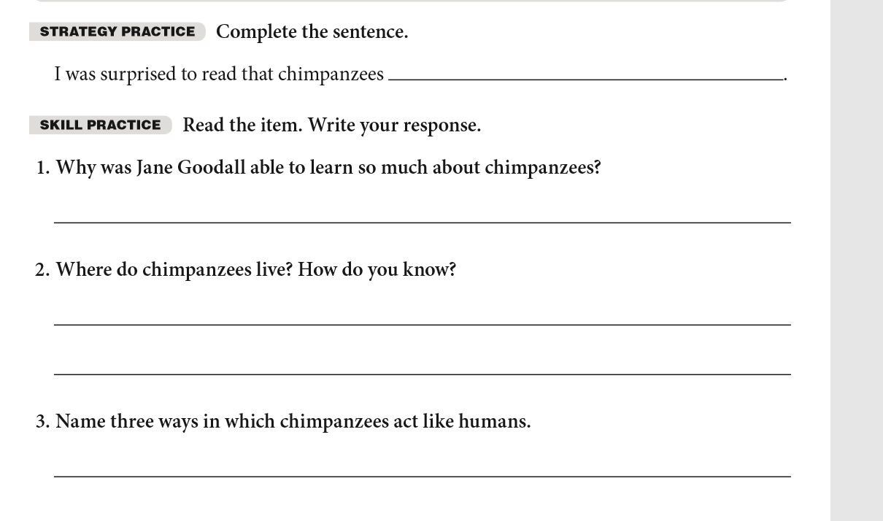

Slide 12
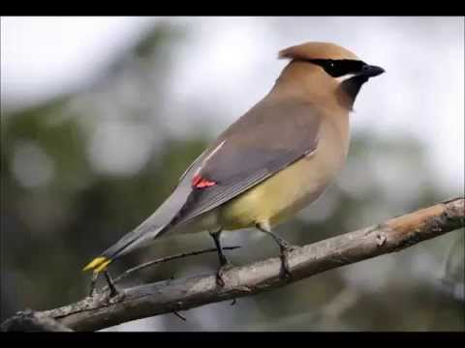
Wingwax Song Birds

Slide 13
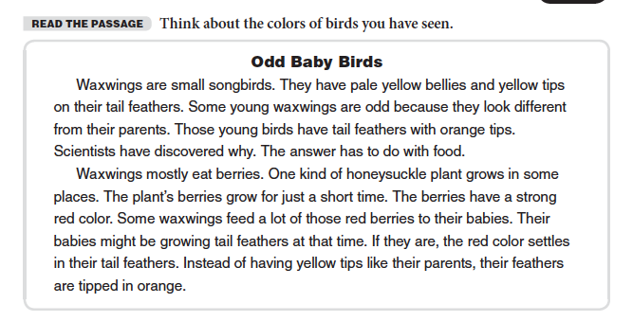

Slide 14
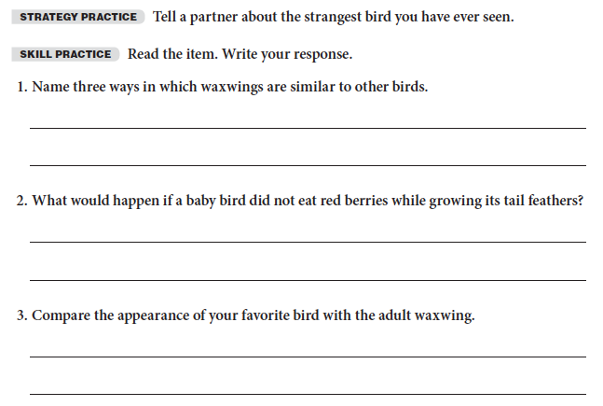

Slide 15
Review what we learned
Meet Dojo- Power of Mistakes
Learn how to grow your brain
Vocabulary
Making Connections

Slide 16
Lesson 2 Goal
Practice Making Connections and visualizing the stories you are reading!
Website

Slide 17
Thanks!
Any questions?
You can always email me:
kelly.west@heartlandcharterschool.org

