Slide 1
Comprehension
Lesson 1
Mrs.West

Slide 2
Review our Procedures
Give it your BEST try.
Use tools appropriately .
Be Respectful.
The power of YET

Slide 3
I Can!
I can describe the characters in a story and explain how their actions add to the story’s events.
I can determine the meaning of words and phrases I do not know.

Slide 4
Agenda Today
Meet Dojo
Why are Challenges important?
Vocabulary
Visualization

Slide 5
Visualization
Readers use visualization to better understand a text. When
you use visualization, you use details to create pictures in
your mind. You imagine what is happening in the text.

Slide 6
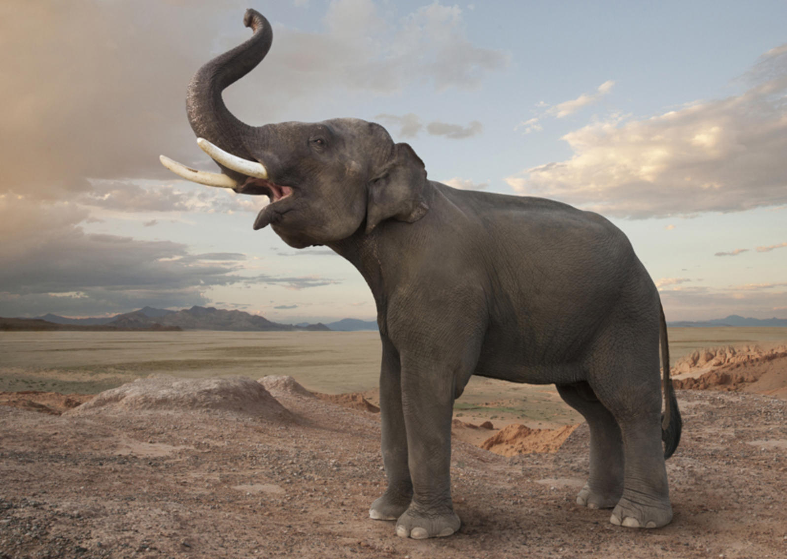

Slide 8
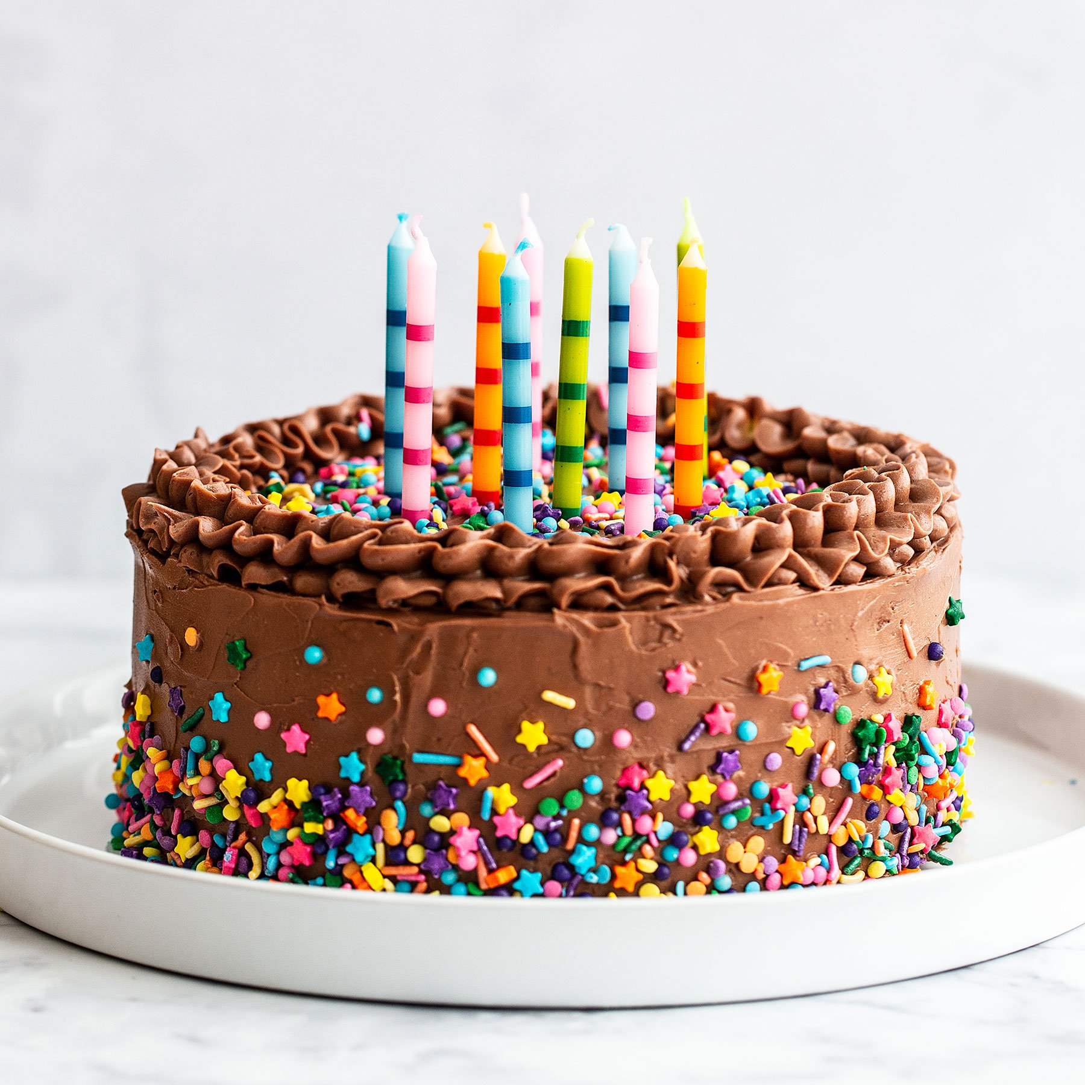

Slide 10
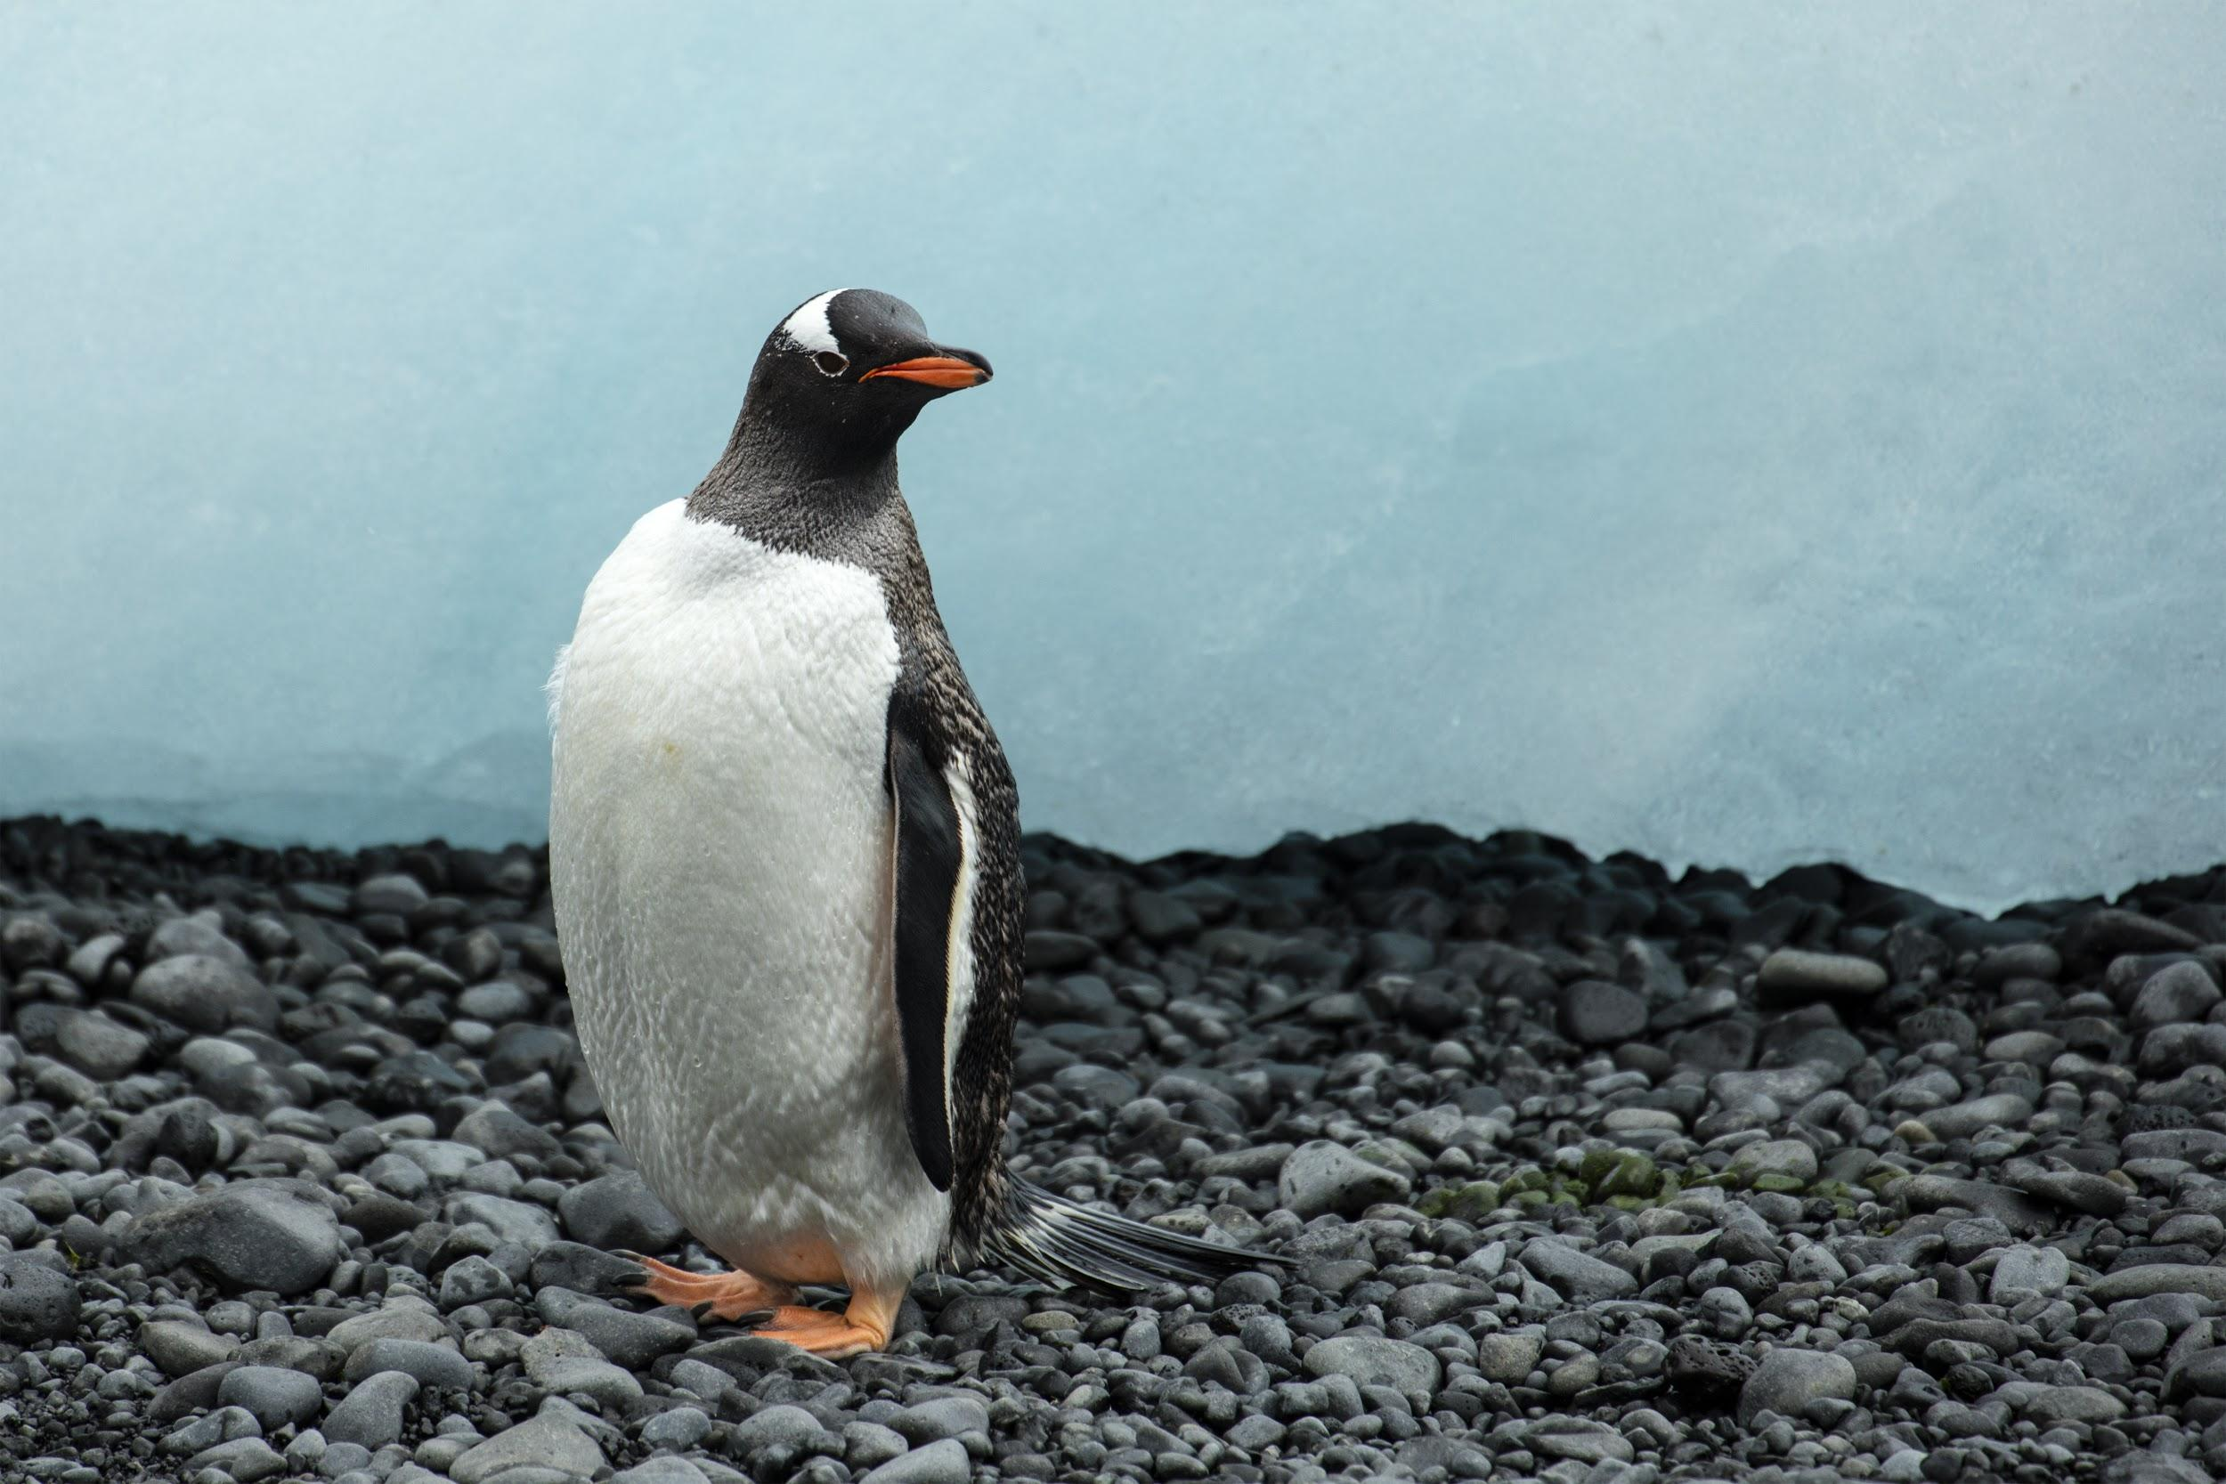
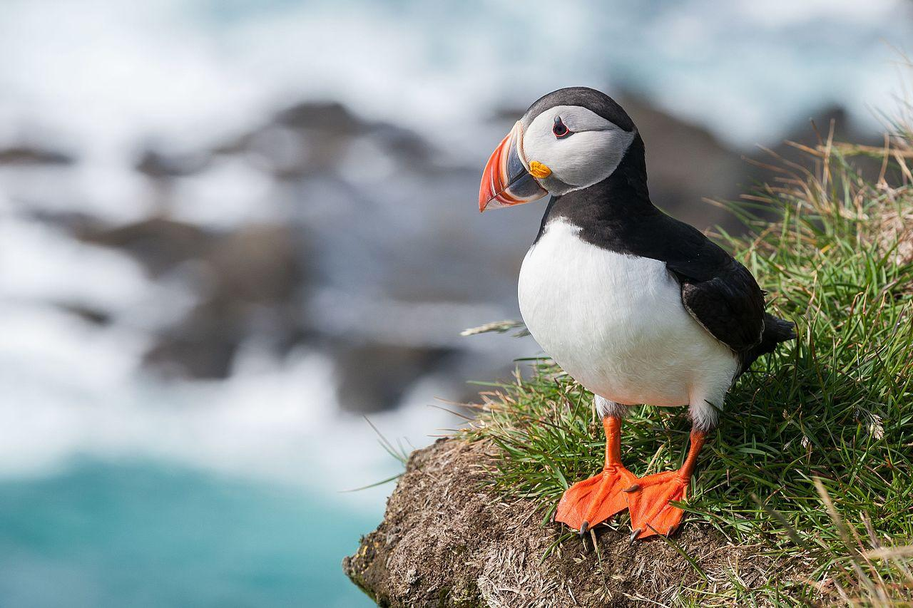
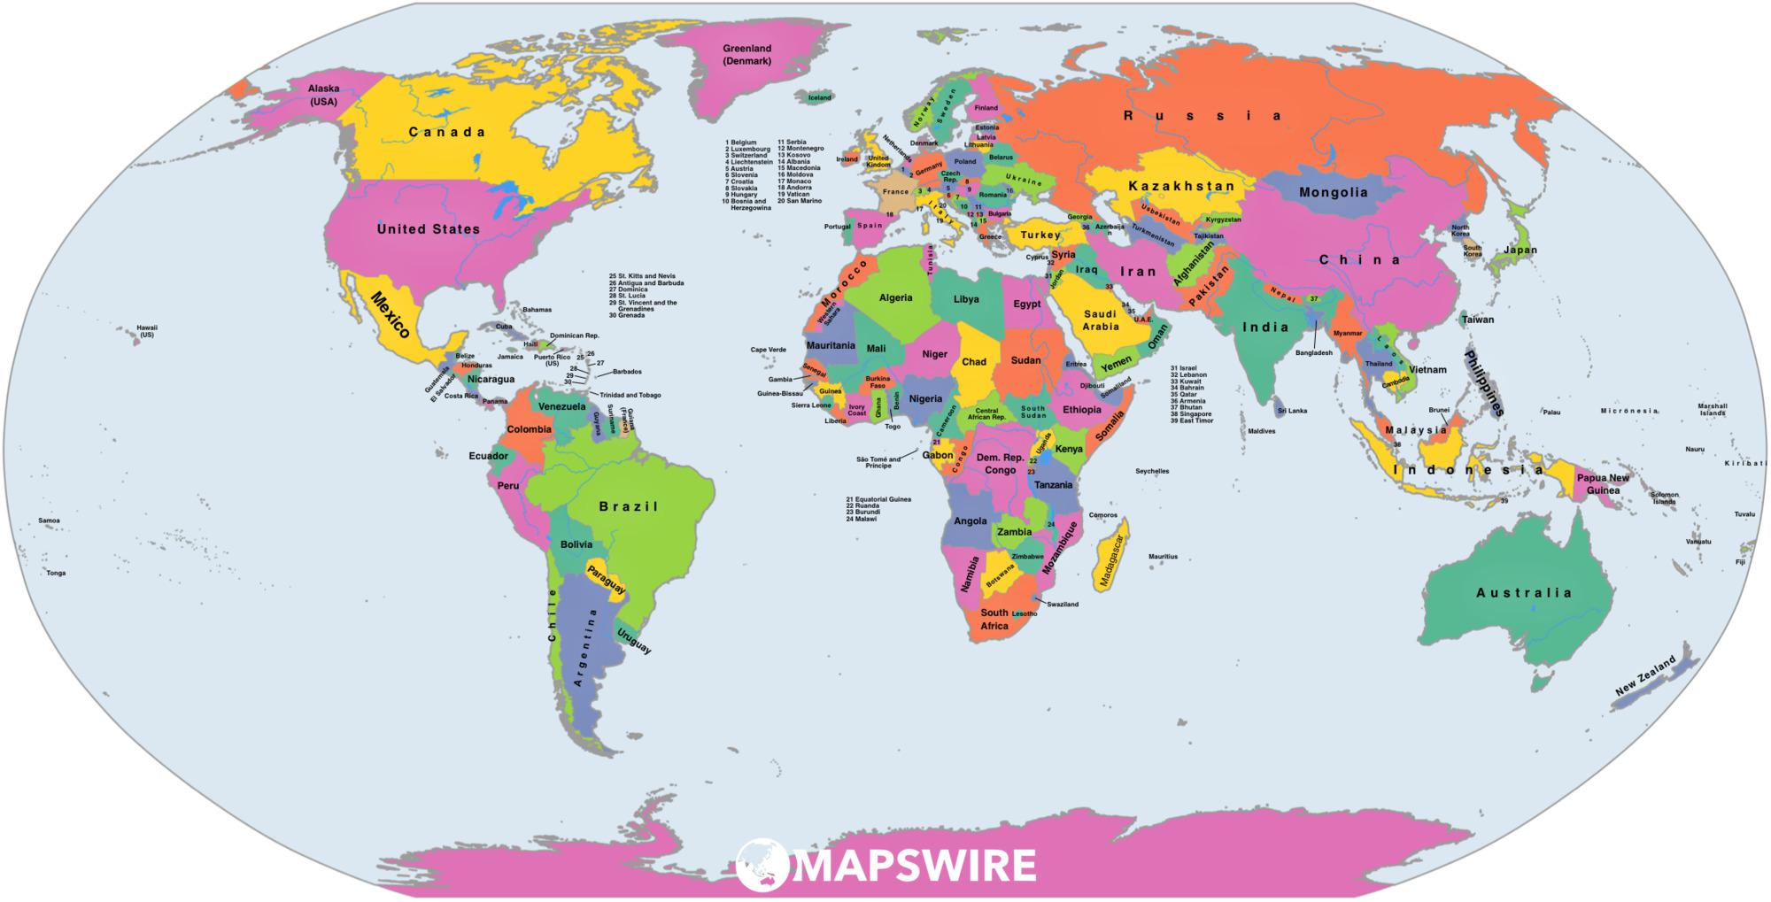
Vocabulary
Puffins
Penguin
North
South

Slide 11
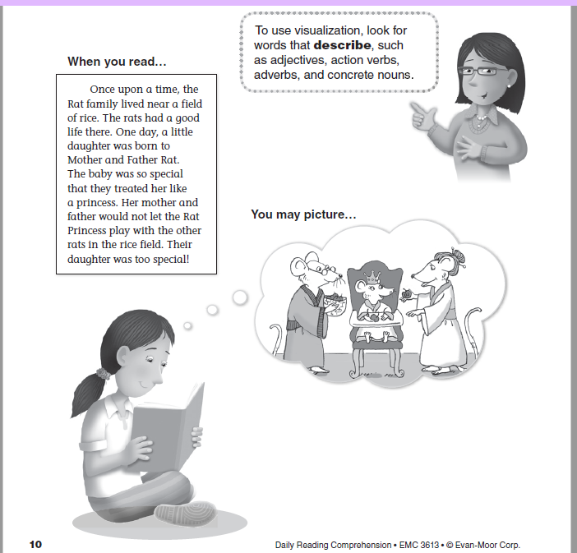

Slide 12
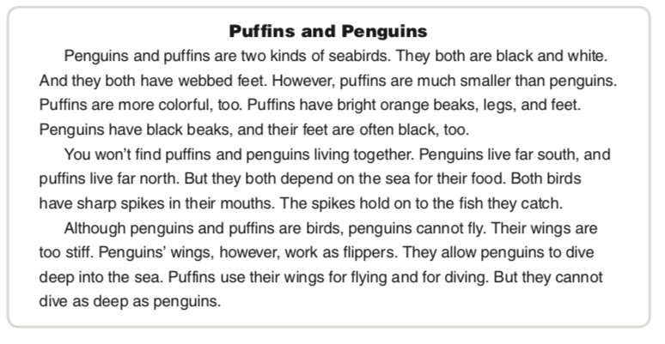

Slide 13
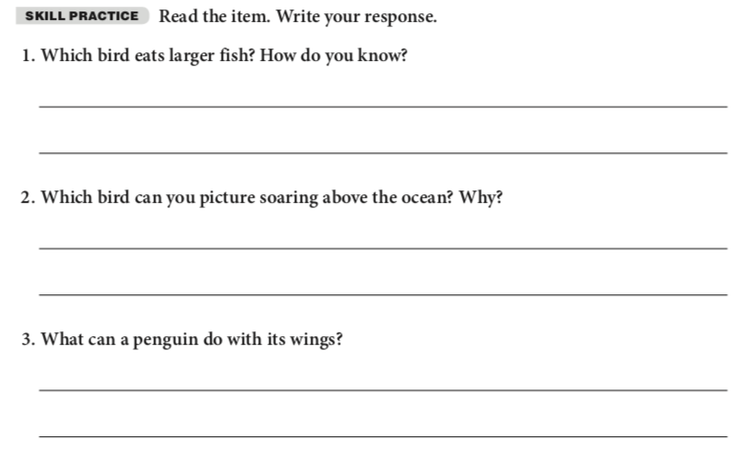

Slide 14
Review what we learned
Meet Dojo
Why are Challenges important?
Vocabulary
Visualization

Slide 15
Week 1 Goal
Practice Making Connections to the stories you are reading!
Practice Visualizing the story! Make a movie in your head.
Website

Slide 16
Thanks!
Any questions?
You can always email me:
kelly.west@inspireschools.org

