Slide 1
How to Run a virtual practice test session with your students

Slide 2
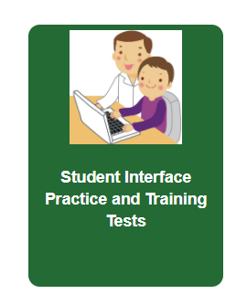
Virtual Practice Session
You will want to run at least one, but if possible two, practice virtual test sessions with your students prior to test day. The second one should be not more than 2 weeks before their test date.
It is important to do this so that students have a chance to get comfortable with the new platform and tools they will be using during the test.
We suggest only one family at a time
Use the provided slide show to teach students how to use the practice test. Virtual Practice test directions for students

Slide 3
There are two different ways to run a practice test
Through the practice portal on the CAASPP website while running zoom.
The student uses the secure browser to log into the practice test. This simulates how they will log into the actual test. No other applications can be open on the student’s screen.

Slide 4
Steps to run a practice session through the CAASPP website
STEP 1: Schedule a zoom meeting with your family
STEP 2: Meet your student/s in zoom and give them instructions on how to log into the test session by showing the provided slide show. Parent slide show for practice test
Or if they cannot zoom here is a document: How to log into a practice test
STEP 3: Put the link to practice test in the chat as well as their SSID number or text the SSID number to the parent. They will need to write it down and have it near the computer.

Slide 5
How to run a practice session using the secure browser
STEP 1: Schedule a time for the practice test with your family. Make sure they have successfully downloaded the secure browser from the CAASPP website prior to the session: here
STEP 2: Start a practice test session from the CAASPP website
STEP 3: Give the parent the student’s SSID number ahead of time by phone or text (do not email). They will need to write it down and have it near the computer.
STEP 4: Have the student open the secure browser on their computer and enter their name, SSID, and the session ID you give them.

Slide 6
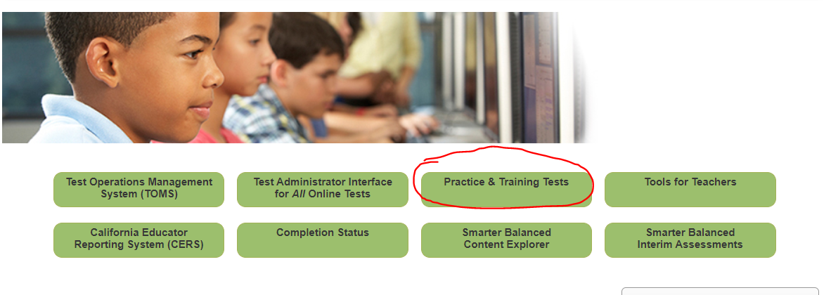
Steps to run a practice session
STEP 4: Log into the practice test: go to caaspp.org and click on “practice and training tests”

Slide 7
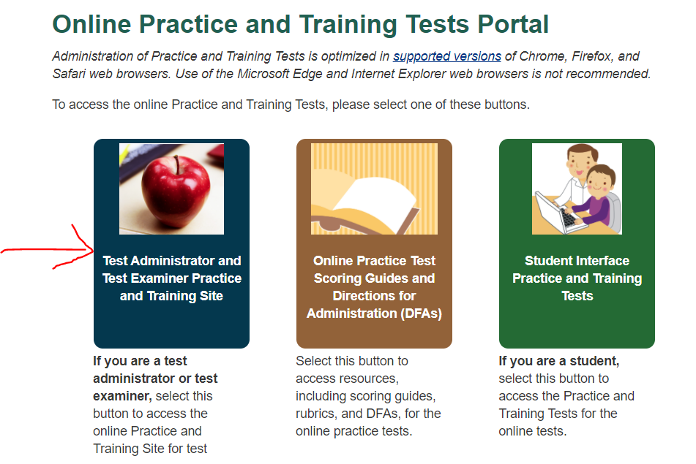
Steps to run a practice session
STEP 5: Click on the blue button to start the practice session

Slide 8
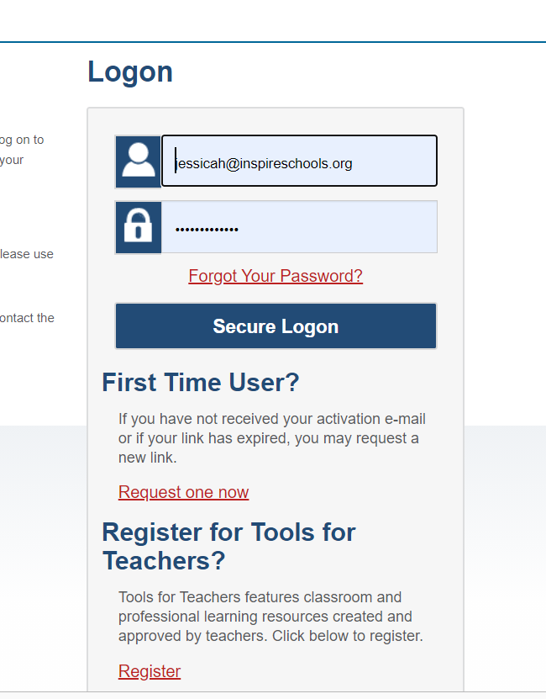
Steps to run a practice session
STEP 6: You will be prompted to sign into TOMS
You will want to make sure your TOMs account is working and you know the password before holding the practice session

Slide 9
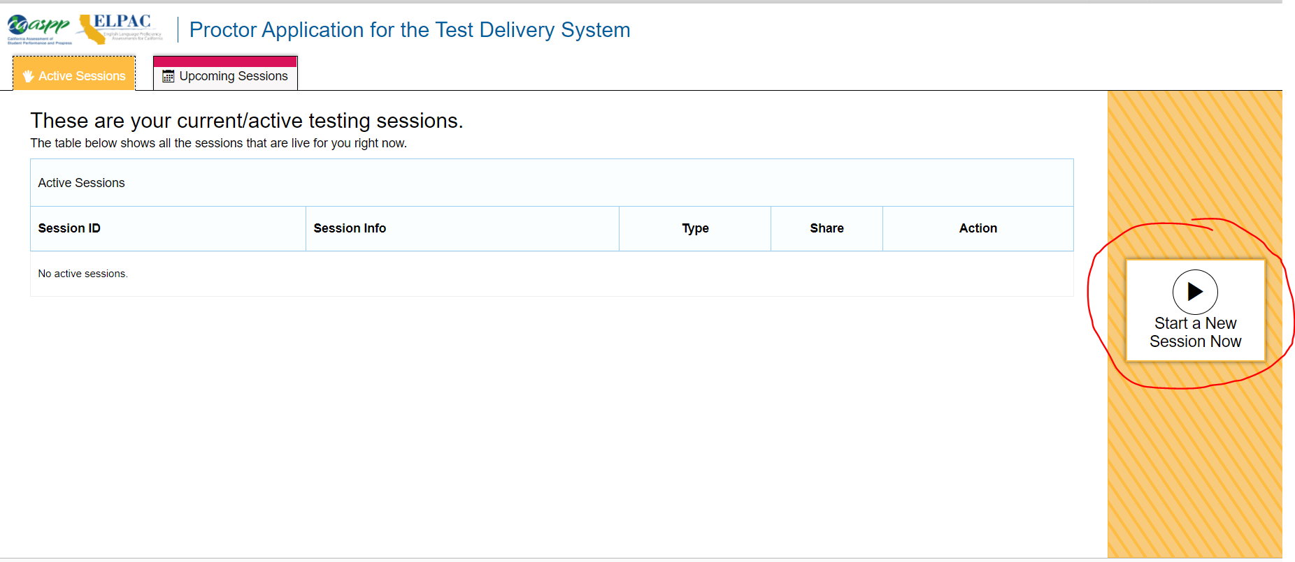
Steps to run a practice session
STEP 7: Click on “Start a New Session Now”

Slide 10
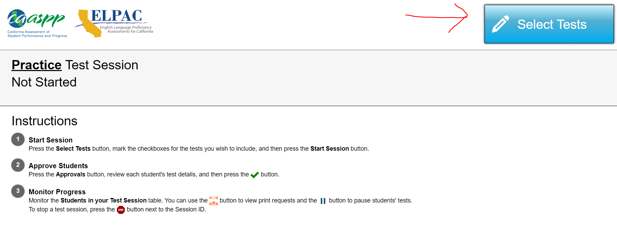
Steps to run a practice session
STEP 8: Select tests for the grade level you are administering to.

Slide 11
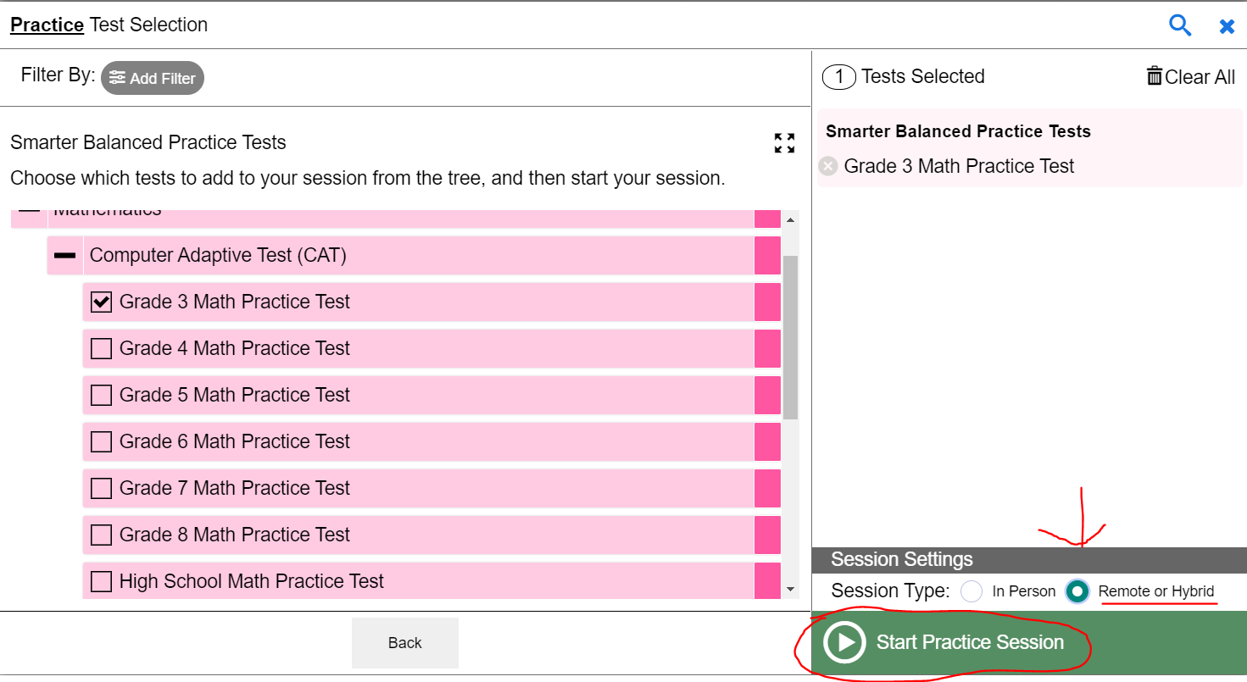
Steps to run a practice session
STEP 9: Choose your tests, click “remote or hybrid”, and start the session

Slide 12
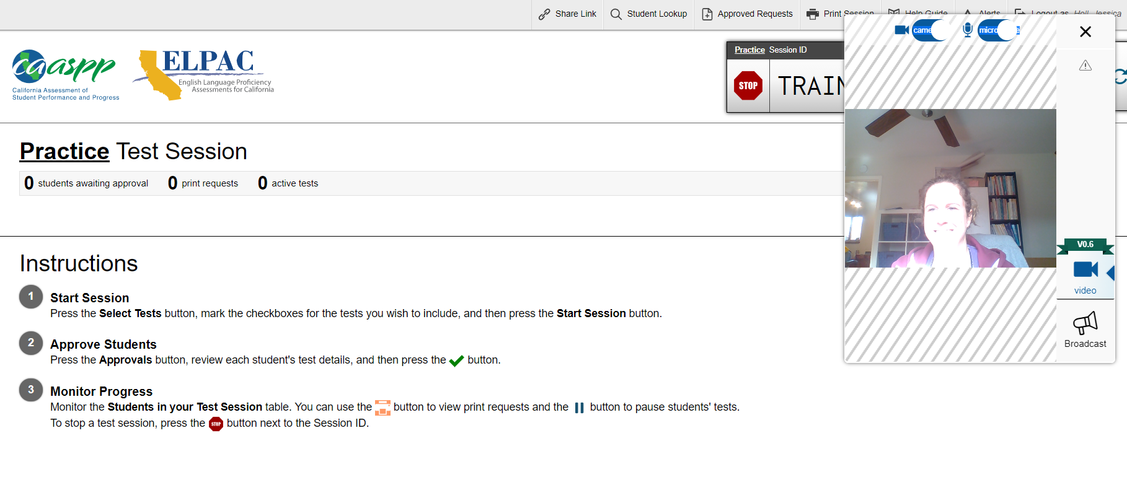
Steps to run a practice session
STEP 10: You will need to enable your video camera and microphone, your screen will look like this with the communication widget open.

Slide 13
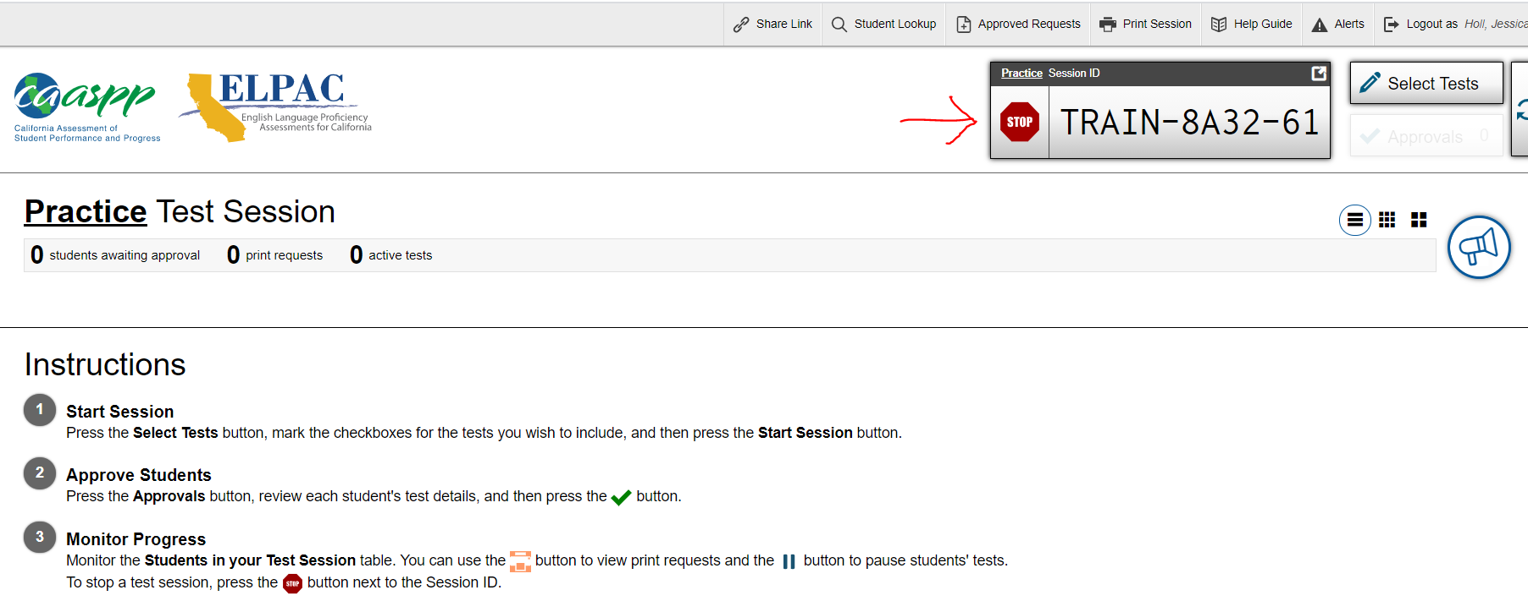
Steps to run a practice session
STEP 11: Give students the session ID. They will enter it into the practice test along with their SSID.

Slide 14
Steps to run a practice session
STEP 12: Help students to log in to the practice test
Have students go to the practice and training website: https://www.caaspp.org/practice-and-training/index.html
Show these slides on your zoom screen to guide them through logging in: Virtual practice test directions for students

Slide 15
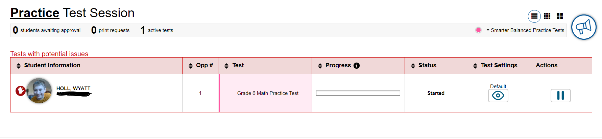
Steps to run a practice session
STEP 13: Have student practice raising their hand

Slide 16
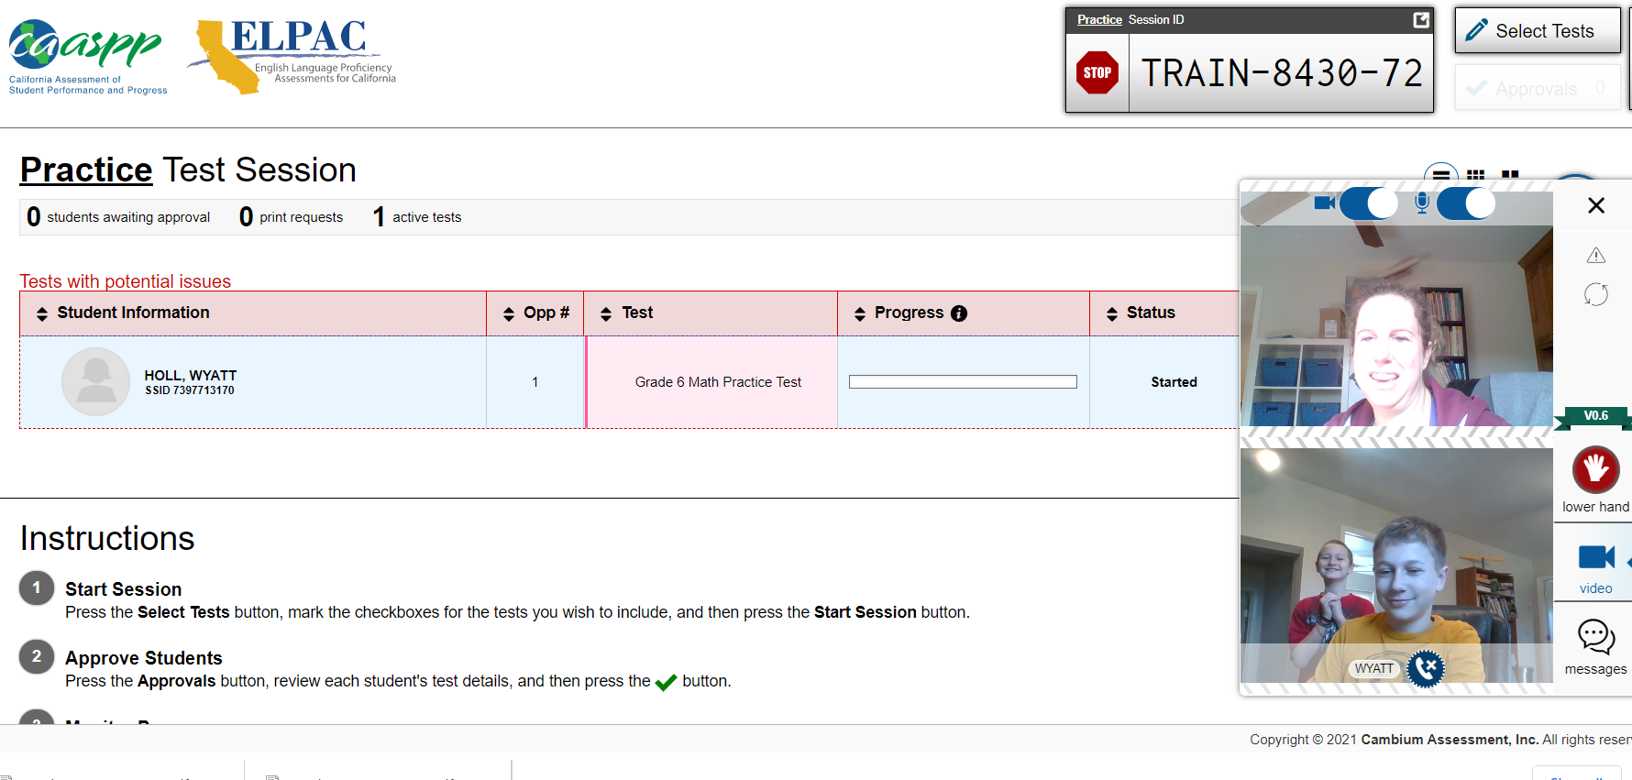
Steps to run a practice session
STEP 13: Click on the student’s raised hand and click the phone button to have a video conversation with the student.

Slide 17
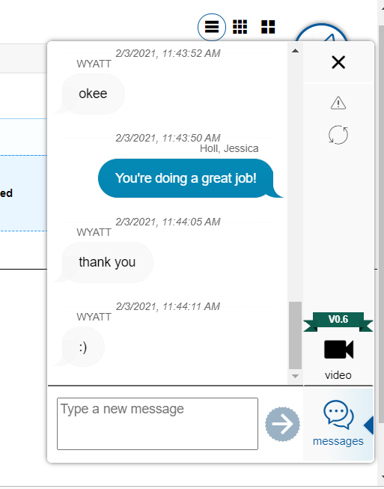

Steps to run a practice session
STEP 14: Have the student click on the message button to text message with you in a private chat.

Slide 18
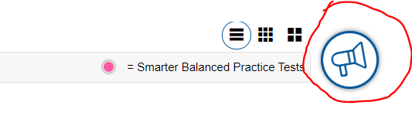
Steps to run a practice session
STEP 15: Click on the broadcast button to send a message to all students that will be sent as a text and also read aloud to them

Slide 19
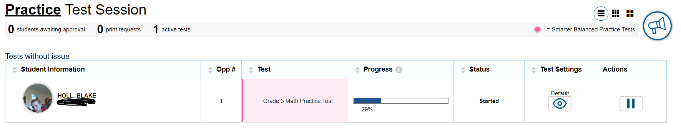
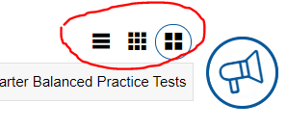
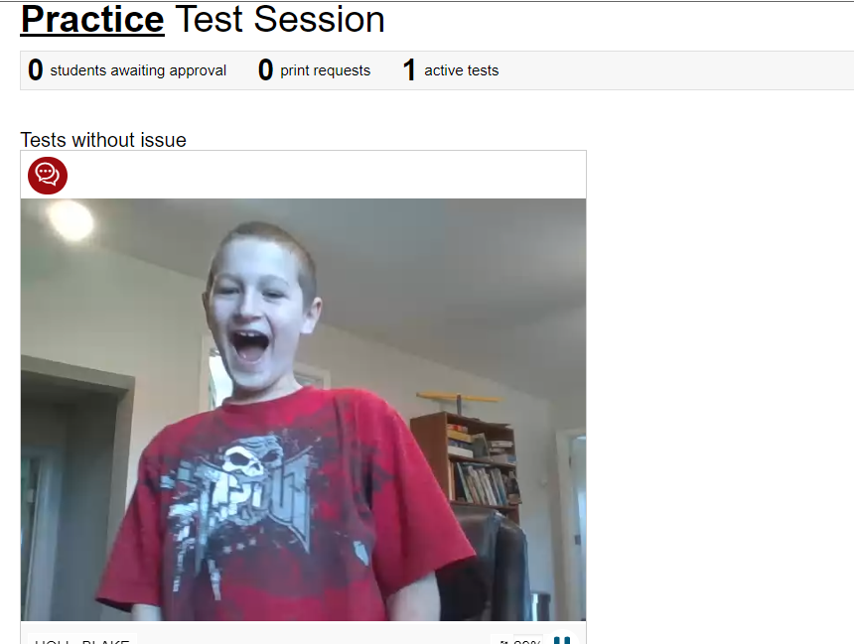
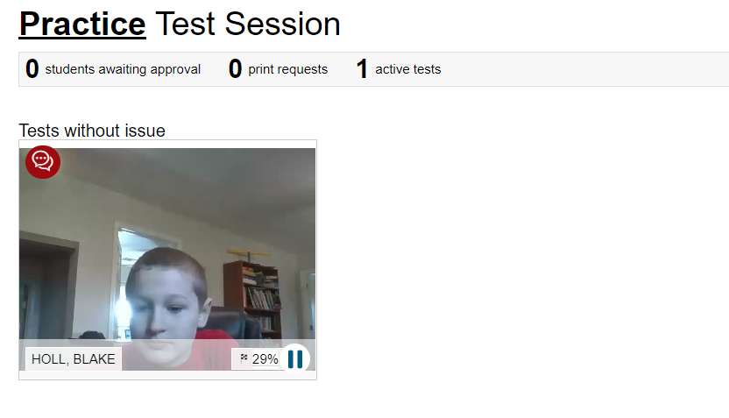
Steps to run a practice session
STEP 16: Change your view by clicking these buttons in the upper right corner.

Slide 20
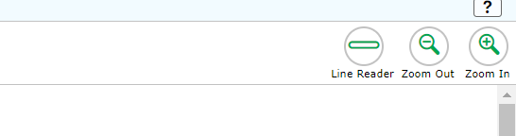
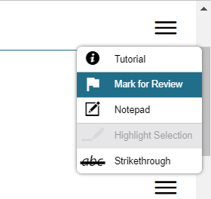
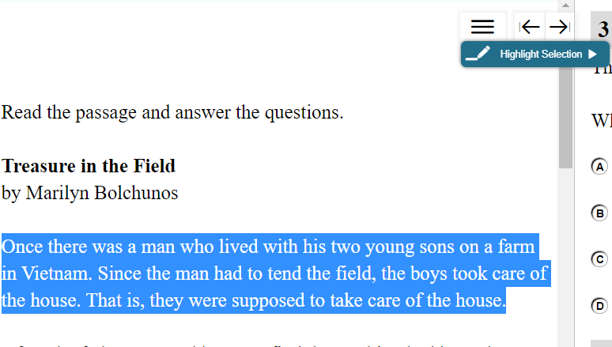
Steps to run a practice session
STEP 17: Run the students through a practice test, they can share their screen with you on zoom if they don’t know how to answer a question. It’s ok if they guess answers on the practice test. The goal is for them to learn to use the functions within the test.
Have them try out these functions:
Zoom in/out
Line reader
Strikethrough
Notepad
Mark for Review

Slide 21
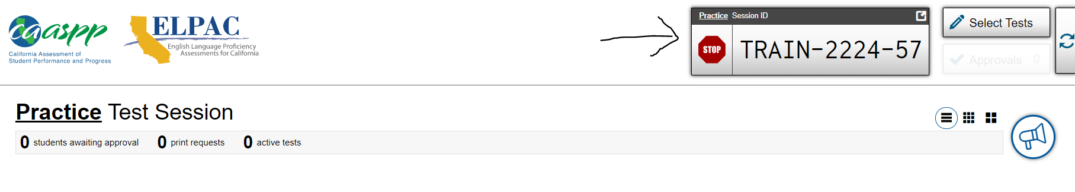
Steps to run a practice session
STEP 18: Select “Stop” to end the test session

